Slide 1

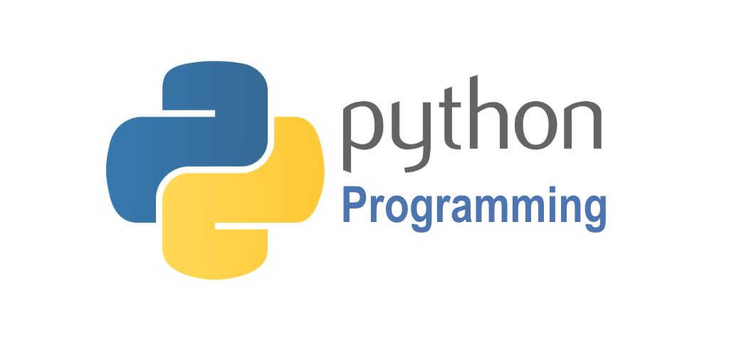
PYTHON (3.8.8)

Slide 2
What is Program?
A computer program is a collection of instructions that can be executed by a computer to perform a specific task. A computer program is usually written by a computer programmer in a programming language.

Slide 3
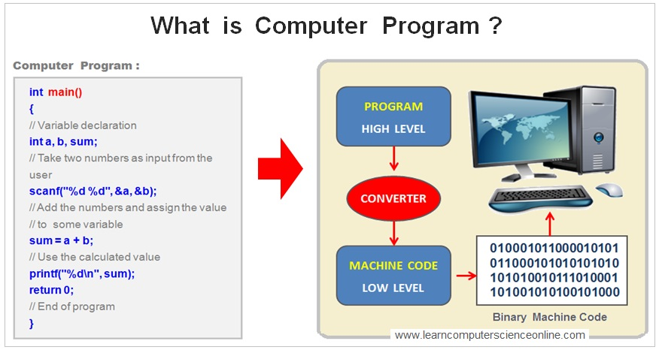

Slide 4
Python Level-1
Introduction to Python
Conditional Statements
String Manipulation
Tuple
Sets
Lists
Dictionaries
Functions
Files
Exceptional Handling
OOP
Regular Expression
Mini Project

Slide 5
History
It was developed in the year 1989 but released in 1991. but in usage 2008 onwards.
Python author is Guido van Rossum. He is a big fan of British comedy movie named “Python Flying Circus”. So he named as python.

Slide 6
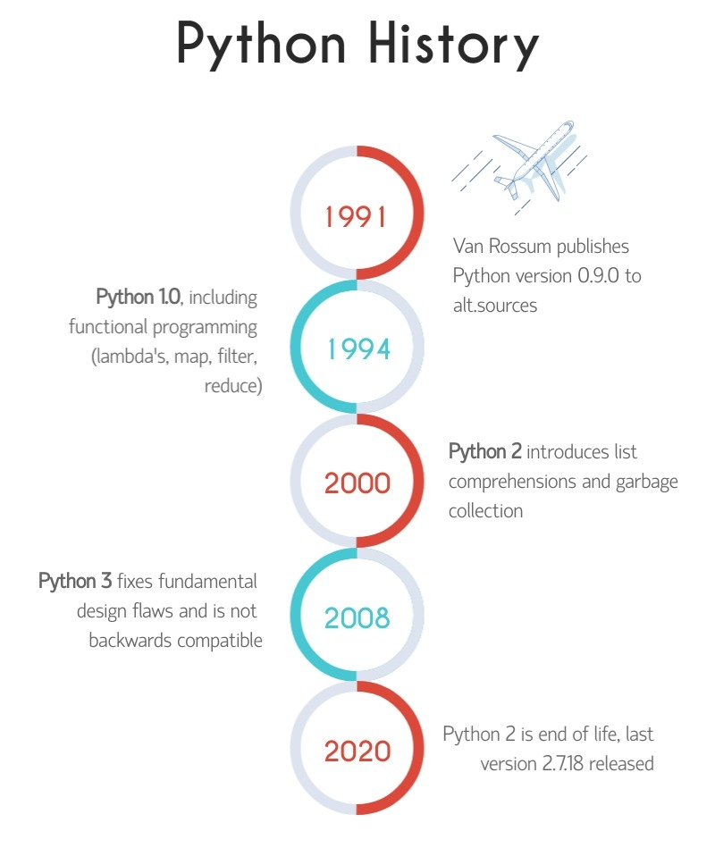

Slide 7
Python
Python is a simple, easy to learn, powerful, high level and object oriented programming language.
Python is an interpreted scripting language also.
Most of the companies like Google, youtube, dropbox, yahoo, NASA using python language.
Python is used in several areas like machine learning, S/W development, GUI and web development. So it is called GPL( General Purpose Language)
Python can be used in data Science also for developing projects.

Slide 8
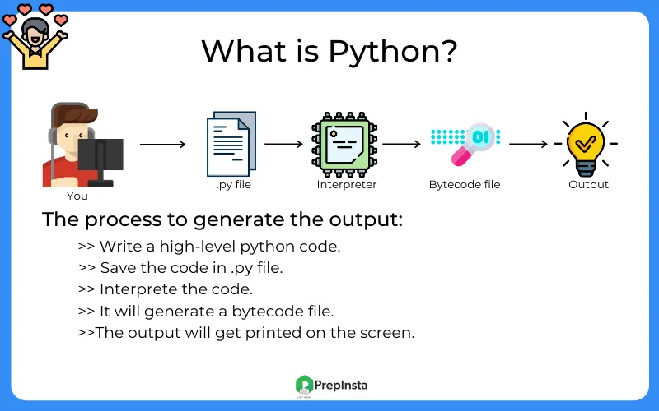

Slide 9
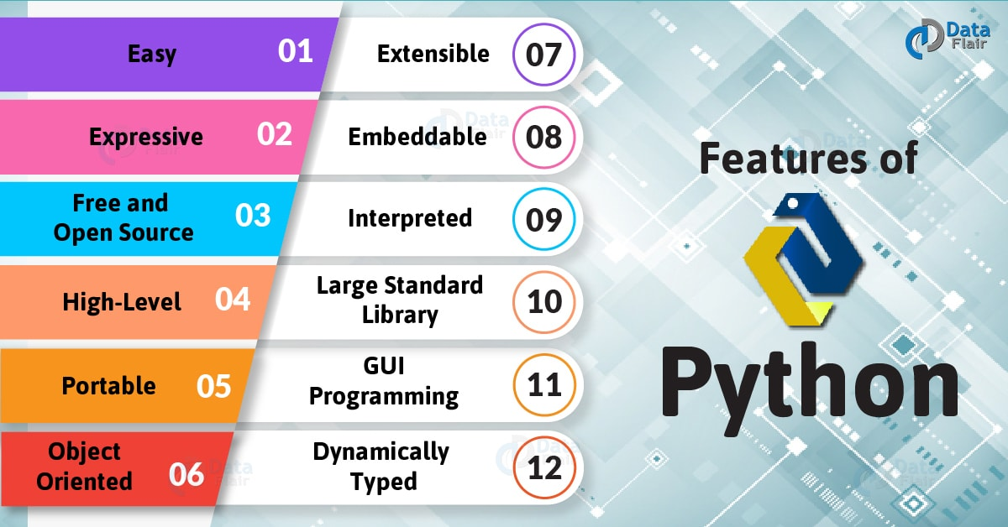

Slide 10
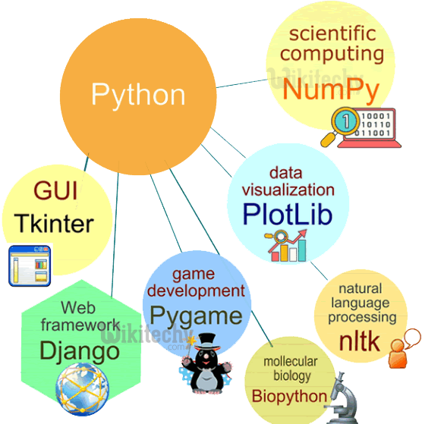

Slide 11
Python Syntax
Execute Python Syntax:
print("Hello, World!") Hello, World
Python Indentation:
Indentation refers to the spaces at the beginning of a code line. Python uses indentation to indicate a block of code.
1. If 10>5:
Print(“10 is greater than 5”)
Creating a Comment: using #
#print("Hello, World!")

Slide 12
Python Variables
Variables are containers for storing data values.
Creating Variables
Python has no command for declaring a variable.
A variable is created the moment you first assign a value to it.
Example
x = 5 Integer y = "John” String print(x) print(y)
It may any type

Slide 13
1. Variable is a name that is used to refer to memory location. 2. Python variable is also known as an identifier and used to hold value.
RULES :-
The first character of the variable must be an alphabet or underscore ( _ )
All the characters except the first character may be an alphabet of lower-case(a-z),
upper-case (A-Z), underscore, or digit (0-9).
3. Identifier name must not contain any white-space, or special character (!, @, #, %, ^, &, *).
EXAMPLE:-
→Examples of valid identifiers: a123, _n, n_9, etc.
→Examples of invalid identifiers: 1a, n%4, n 9, etc.

Slide 14
Variables
Casting
If you want to specify the data type of a variable, this can be done with casting.
Example
a=int(3), b=str(3), c=float(3)
Type ()
X=5, y=10
Print(type(x))
Print(type(y))
O/P: It returns what type of Datatype

Slide 15


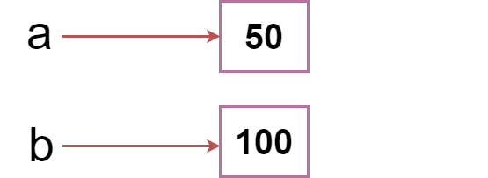
VARIABLE EXAMPLE
A=50
A=b=50
A=50 , b= 100

Slide 16
Multiple Assignment
Assign single value to Multiple Variables
Eg: a=b=c=50
Print(a)
Print(b)
Print(c)
Assign Multiple Values to Multiple Variables
Eg:a=b=c=5,10,15
Print(a)
Print(b)
Print(c)

Slide 17
Output Variables
1. x="awesome"
print("python is" + x)
2. x="python is"
y="awesome"
z= x + y
print(z)
3. x=5
y=10
print(x+y)

Slide 18
Python Datatypes
Variables can store data of different types, and different types can do different things.
Python has the following data types built-in by default, in these categories:
Built-in Datatypes:
Text Type: | str
Numeric Types: | int, float, complex
Sequence Types: | list, tuple, range
Mapping Type: | dict
Set Types: | set, frozenset
Boolean Type: | bool
Binary Types: | bytes, bytearray, memoryview

Slide 19
Setting Datatype
Example | Data Type
x = "Hello World" | str
x = 20 | int
x = 20.5 | float
x = 1j | complex
x = ["apple", "banana", "cherry"] | list
x = ("apple", "banana", "cherry") | tuple
x = range(6) | range
x = {"name" : "John", "age" : 36} | dict
x = {"apple", "banana", "cherry"} | set
x = frozenset({"apple", "banana", "cherry"}) | frozenset
x = True | bool
x = b"Hello" | bytes
x = bytearray(5) | bytearray
x = memoryview(bytes(5)) | memoryview

Slide 20
Type Conversion
You can convert from one to another type with the int(), float (), Complex() methods
A=5, b=10.0,c=5i
Print(a),print(b),print(c)
Print(float(a)),print(int(b)),print(complex(a))
Random Numbers: Python does not have have random() function .but have built-in function random()
Eg: import random
Print(random.randrange(1,10))

Slide 21
Python Operators
It divides
Arithmetic operators
Assignment Operators
Comparison Operator
Logical Operator
Identity Operator
Membership Operator

Slide 22
Python Arithmetic Operators
Arithmetic operators are used with numeric values to perform common mathematical operations:
Operator | Name | Example
+ | Addition | x + y
- | Subtraction | x - y
* | Multiplication | x * y
/ | Division | x / y
% | Modulus | x % y
** | Exponentiation | x ** y
// | Floor division | x // y

Slide 23
Python Assignment Operators
Assignment operators are used to assign values to variables:
Operator | Example | Same As
= | x = 5 | x = 5
+= | x += 3 | x = x + 3
-= | x -= 3 | x = x - 3
*= | x *= 3 | x = x * 3
/= | x /= 3 | x = x / 3
%= | x %= 3 | x = x % 3
//= | x //= 3 | x = x // 3
**= | x **= 3 | x = x ** 3
&= | x &= 3 | x = x & 3
|= | x |= 3 | x = x | 3
^= | x ^= 3 | x = x ^ 3
>>= | x >>= 3 | x = x >> 3
<<= | x <<= 3 | x = x << 3

Slide 24
Python comparison and logical operators
Operator | Name | Example
== | Equal | x == y
!= | Not equal | x != y
> | Greater than | x > y
< | Less than | x < y
>= | Greater than or equal to | x >= y
<= | Less than or equal to | x <= y
Operator | Description | Example
and | Returns True if both statements are true | x < 5 and x < 10
or | Returns True if one of the statements is true | x < 5 or x < 4
not | Reverse the result, returns False if the result is true | not(x < 5 and x < 10)

Slide 25
Python Identity & Membership Operator
Identity: It is compare the objects, not if they are equal, but if they are actually the same object, with the same memory location.
Membership Operator: Are used to test if a sequence is presented in object.
Operator | Description | Example
is | Returns True if both variables are the same object | x is y
is not | Returns True if both variables are not the same object | x is not y
Operator | Description | Example
in | Returns True if a sequence with the specified value is present in the object | x in y
not in | Returns True if a sequence with the specified value is not present in the object | x not in y

Slide 26
Python Modules
Pandas
Sympy
Numpy
Scipy
Pillow
Sklearn
Beautifulsoup
Pymongo
pygame

Slide 27
Conditional Statements
If Statement: Condition true returns true value.
Elif: The elif keyword is pythons way of saying "if the previous conditions were not true, then try this condition".
Else: The else keyword catches anything which isn't caught by the preceding conditions.
Short Hand If
Short Hand If ... Else
And
OR
Nested if
Pass

Slide 28
Loops
Two primitive loops used in python
While Loops
For Loops
While Loops: it execute as soon as condition is true.
Break Statement: we can stop the loop even if the while condition is true
Continue Statement: we can stop current iteration and continue with the next.

Slide 29
For Loop
For Loop: it is used for iterating over a sequence (list, tuple, a set or a string)
Looping Through a String
Break
Continue
Range Function()
Nested loop

Slide 30
String Manipulation-String Methods
Method | Description
capitalize() | Converts the first character to upper case
casefold() | Converts string into lower case
center() | Returns a centered string
count() | Returns the number of times a specified value occurs in a string
encode() | Returns an encoded version of the string
endswith() | Returns true if the string ends with the specified value
expandtabs() | Sets the tab size of the string
find() | Searches the string for a specified value and returns the position of where it was found
format() | Formats specified values in a string
format_map() | Formats specified values in a string
index() | Searches the string for a specified value and returns the position of where it was found
isalnum() | Returns True if all characters in the string are alphanumeric
isalpha() | Returns True if all characters in the string are in the alphabet

Slide 31
isdecimal() | Returns True if all characters in the string are decimals
isdigit() | Returns True if all characters in the string are digits
isidentifier() | Returns True if the string is an identifier
islower() | Returns True if all characters in the string are lower case
isnumeric() | Returns True if all characters in the string are numeric
isprintable() | Returns True if all characters in the string are printable
isspace() | Returns True if all characters in the string are whitespaces
istitle() | Returns True if the string follows the rules of a title
isupper() | Returns True if all characters in the string are upper case
join() | Joins the elements of an iterable to the end of the string
ljust() | Returns a left justified version of the string
lower() | Converts a string into lower case
lstrip() | Returns a left trim version of the string
maketrans() | Returns a translation table to be used in translations
partition() | Returns a tuple where the string is parted into three parts
replace() | Returns a string where a specified value is replaced with a specified value
rfind() | Searches the string for a specified value and returns the last position of where it was found
rindex() | Searches the string for a specified value and returns the last position of where it was found
rjust() | Returns a right justified version of the string
rpartition() | Returns a tuple where the string is parted into three parts
rsplit() | Splits the string at the specified separator, and returns a list
rstrip() | Returns a right trim version of the string
split() | Splits the string at the specified separator, and returns a list
splitlines() | Splits the string at line breaks and returns a list
startswith() | Returns true if the string starts with the specified value
strip() | Returns a trimmed version of the string
swapcase() | Swaps cases, lower case becomes upper case and vice versa
title() | Converts the first character of each word to upper case
translate() | Returns a translated string
upper() | Converts a string into upper case
zfill() | Fills the string with a specified number of 0 values at the beginning

Slide 32
Python String
String can be presented in double quotes or single quotes. It can be used in print statement. Eg: print(“hello”), print(‘hello’)
Assign String to a Variable
Multiline string: three single or double quotes
Strings are array
Looping Through a String
String length
Check string: using keyword in
Check if NOT

Slide 33
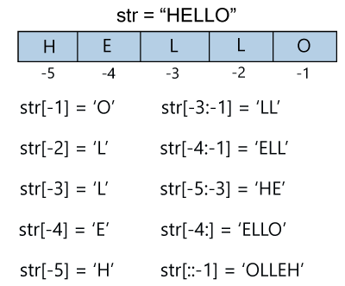
Slicing String
Slicing: Return the range of characters by using the slice syntax.
Slice From the Start
Slice to the End
Negative indexing:

Slide 34
Python Modify & Concatenate Strings
Built in methods to access the strings
Upper Case: upper()
Lower Case: lower()
Remove Whitespace: strip()
Replace String: replace()
Split String: split()
Concatenate Strings
Escape Character: using \ (backslash)
String Format: format()

Slide 35

Python Tuples
Tuples are used to store multiple items in a single variable.
Tuple is one of 4 built-in data types in Python used to store collections of data, the other 3 are List, Set, and Dictionary, all with different qualities and usage.
A tuple is a collection which is ordered and unchangeable.
Tuples are written with round brackets.
Eg
: mytuple(“apple”, “banana”, “cherry”)
Tuple Items
Tuple items are ordered, unchangeable, and allow duplicate values.
Tuple items are indexed, the first item has index [0], the second item has index [1] etc.
Tuple Length: To determine how many items a tuple has, use the len() function:

Slide 36

Python Access Tuple Items
Access Tuple Items
Negative Indexing
Range of Indexes
Range of –ve indexes
Check if item exist
Change Tuple Values: Once a tuple is created, you cannot change its values. Tuples are unchangeable, or immutable as it also is called.
But there is a workaround. You can convert the tuple into a list, change the list, and convert the list back into a tuple. using append()
Join Tuples
Python Loops: for, while

Slide 37
Python sets
Sets are used to store multiple items in a single variable.
Set is one of 4 built-in data types in Python used to store collections of data, the other 3 are List, Tuple, and Dictionary, all with different qualities and usage.
A set is a collection which is both unordered and unindexed.
Using for loop
Intersection method (keep only duplicate values)
Symmetric_difference_update

Slide 38
Set Methods
add() | Adds an element to the set
clear() | Removes all the elements from the set
copy() | Returns a copy of the set
difference() | Returns a set containing the difference between two or more sets
difference_update() | Removes the items in this set that are also included in another, specified set
discard() | Remove the specified item
intersection() | Returns a set, that is the intersection of two other sets
intersection_update() | Removes the items in this set that are not present in other, specified set(s)
isdisjoint() | Returns whether two sets have a intersection or not
issubset() | Returns whether another set contains this set or not
issuperset() | Returns whether this set contains another set or not
pop() | Removes an element from the set
remove() | Removes the specified element
symmetric_difference() | Returns a set with the symmetric differences of two sets
symmetric_difference_update() | inserts the symmetric differences from this set and another
union() | Return a set containing the union of sets
update() | Update the set with the union of this set and others

Slide 39
Lists
List Items
Lists are used to store multiple items in a single variable.
Lists are one of 4 built-in data types in Python used to store collections of data, the other 3 are Tuple, Set, and Dictionary, all with different qualities and usage.
Lists are created using square brackets:
List items: List items are ordered, changeable, and allow duplicate values.
List items are indexed, the first item has index [0], the second item has index [1] etc.
Changeable: The list is changeable, meaning that we can change, add, and remove items in a list after it has been created.

Slide 40
Method | Description
append() | Adds an element at the end of the list
clear() | Removes all the elements from the list
copy() | Returns a copy of the list
count() | Returns the number of elements with the specified value
extend() | Add the elements of a list (or any iterable), to the end of the current list
index() | Returns the index of the first element with the specified value
insert() | Adds an element at the specified position
pop() | Removes the element at the specified position
remove() | Removes the item with the specified value
reverse() | Reverses the order of the list
sort() | Sorts the list

Slide 41
Dictionaries
Dictionaries are used to store data values in key: value pairs.
A dictionary items is a collection which is ordered*, changeable and does not allow duplicates.
Dictionary items are presented in key:value pairs, and can be referred to by using the key name.
Method | Description
clear() | Removes all the elements from the dictionary
copy() | Returns a copy of the dictionary
fromkeys() | Returns a dictionary with the specified keys and value
get() | Returns the value of the specified key
items() | Returns a list containing a tuple for each key value pair
keys() | Returns a list containing the dictionary's keys
pop() | Removes the element with the specified key
popitem() | Removes the last inserted key-value pair
setdefault() | Returns the value of the specified key. If the key does not exist: insert the key, with the specified value
update() | Updates the dictionary with the specified key-value pairs
values() | Returns a list of all the values in the dictionary

Slide 42
Dictionary
Dictionary Items:Dictionary items are presented in key: value pairs, and can be referred to by using the key name.
Order & Unorder:When we say that dictionaries are ordered, it means that the items have a defined order, and that order will not change.
Unordered means that the items does not have a defined order, you cannot refer to an item by using an index.
Nested function

Slide 43
Functions
A function is a block of code which only runs when it is called.
You can pass data, known as parameters, into a function.
A function can return data as a result.
Using def keyword
Arguments:
Information can be passed into functions as arguments.
Arguments are specified after the function name, inside the parentheses. You can add as many arguments as you want, just separate them with a comma.
The following example has a function with one argument (fname). When the function is called, we pass along a first name, which is used inside the function to print the full name:

Slide 44
Arbitary arguments
Key=value
Using default argument also
Passing a list of argument
Lambda argument: A lambda function is a small anonymous function.
A lambda function can take any number of arguments, but can only have one expression.
Syntax:lambda arguments : expression

Slide 45
ZIP, MAP & Filter
The Zip() function returns a zip object, which is an iterator of tuples where the first item in each passed iterator is paired together, and then the second item in each passed iterator are paired together etc.
If the passed iterators have different lengths, the iterator with the least items decides the length of the new iterator.
Syntax: zip(iterator1, iterator2,……)
The Map() function executes a specified function for each item in an iterable. The item is sent to the function as a parameter.
Syntax: map(function, iterables)
The filter() function returns an iterator were the items are filtered through a function to test if the item is accepted or not.
Syntax: filter(function, iterable)

Slide 46
Local & Global Function
Scope: variable is inside the fun()
Local: A variable created inside a function belongs to the local scope of that function, and can only be used inside that function.
Global:Variables that are created outside of a function (as in all of the examples above) are known as global variables.
Global variables can be used by everyone, both inside of functions and outside.

Slide 47
File Handling
File handling is an important part of any web application.
Python has several functions for creating, reading, updating, and deleting files.
Python File Open: Using open() function. Two parameters (filename,mode)
There are four different methods (modes) for opening a file:
In addition:
Syntax:To open a file for reading it is enough to specify the name of the file:
f = open("demofile.txt")
"r" - Read - Default value. Opens a file for reading, error if the file does not exist
"a" - Append - Opens a file for appending, creates the file if it does not exist
"w" - Write - Opens a file for writing, creates the file if it does not exist
"x" - Create - Creates the specified file, returns an error if the file exists
"t" - Text - Default value. Text mode
"b" - Binary - Binary mode (e.g. images)

Slide 48
Write to an existing file:: To write to an existing file, you must add a parameter to the open() function.,
‘a’-Append - will append to the end of the file
“w”- Write - will overwrite any existing content
Create a New File:o create a new file in Python, use the open() method, with one of the following parameters:
“x”-Create - will create a file, returns an error if the file exist
“a”-Append - will create a file if the specified file does not exist
“w”-Write - will create a file if the specified file does not exist
Delete file: To delete a file, you must import the OS module, and run its os.remove() function

Slide 49
Exception Handling
The Try block lets you test a block of code for errors.
The except block lets you handle the error.
The finally block lets you execute code, regardless of the result of the try- and except blocks.
Exception Handling: When an error occurs, or exception as we call it, Python will normally stop and generate an error message. These exceptions can be handled using the try statement.
Methods
Try
Finally
Except
raise

Slide 50
OOP-(Object Oriented Programming)
Python classes/ objects:
Python is an object oriented programming language.
Almost everything in Python is an object, with its properties and methods.
A Class is like an object constructor, or a "blueprint" for creating objects.
Using class keyword.
The init() function is called automatically every time the class is being used to create a new object.
Object Methods: Objects can also contain methods. Methods in objects are functions that belong to the object.
Using self instance. Def _init_(constructor declared in underscore)

Slide 51
Inheritance
Inheritance allows us to define a class that inherits all the methods and properties from another class.
Parent class is the class being inherited from, also called base class.
Child class is the class that inherits from another class, also called derived class.
Super():function that will make the child class inherit all the methods and properties from its parent:

Slide 52
Regular Expression
A RegEx, or Regular Expression, is a sequence of characters that forms a search pattern.
RegEx can be used to check if a string contains the specified search pattern.
Python is build in package called re, which can be used to work with Regular Expressions. Import the re module.
Function | Description
findall | Returns a list containing all matches
search | Returns a Match object if there is a match anywhere in the string
split | Returns a list where the string has been split at each match
sub | Replaces one or many matches with a string

Slide 53
Meta characters
Character | Description | Example
[] | A set of characters | "[a-m]"
\ | Signals a special sequence (can also be used to escape special characters) | "\d"
. | Any character (except newline character) | "he..o"
^ | Starts with | "^hello"
$ | Ends with | "world$"
* | Zero or more occurrences | "aix*"
+ | One or more occurrences | "aix+"
{} | Exactly the specified number of occurrences | "al{2}"
| | Either or | "falls|stays"
() | Capture and group

Slide 54
Search(): The search() function searches the string for a
match, and returns a Match object if there is a match.
If there is more than one match, only the first occurrence of the match will be returned.
The Split(): function returns a list where the string has been split at each match.
The Sub(): function replaces the matches with the text of your choice.
Match Object: A Match Object is an object containing information about the search and the result.
The Match object has properties and methods used to retrieve information about the search, and the result:
Span():returns a tuple containing the start-, and end positions of the match.
String:returns the string passed into the function
Group():returns the part of the string where there was a match

